Slide 1


Green Pace
Security Policy Presentation
Developer: Luke Kundinger

Slide 2

OVERVIEW: DEFENSE IN DEPTH

Slide 3
THREATS MATRIX
Likely INT-036-C INT-033-C STR-030-C STR-002-C MEM-051-CPP ERR-051-CPP DCL-030-C ARR-038-C ENV-032-C | Priority STR-002-C MEM-051-CPP ARR-038-C ENV-032-C STR-030-C
Low priority INT-033-C DCL-030-C ERR-051-CPP INT-036-C DCL-003-C | Unlikely DCL-003-C

Slide 4
10 PRINCIPLES
Validate Input Data
Heed Compiler Warnings
Architect and Design for Security Policies
Keep it Simple
Default Deny
Adhere to the Principle of Least Privilege
Sanitize Data Sent to Other Systems
Practice Defense in Depth
Use Effective Quality Assurance Techniques
Adopt a Secure Coding Standard

Slide 5
CODING STANDARDS
INT-036-C: Converting a pointer to integer or integer to pointer
INT-033-C: Ensure that division and remainder operations do not result in divide-by-zero errors
STR-002-C: Sanitize data passed to complex subsystems
MEM-051-CPP: Properly deallocate dynamically allocated resources
DCL-033-C: Use a static assertion to test the value of a constant expression
ERR-051-CPP: Handle all exceptions
DCL-030-C: Declare objects with appropriate storage durations
ARR-038-C: Guarantee that library functions do not form invalid pointers
ENV-032-C: All exit handlers must return normally

Slide 6
ENCRYPTION POLICIES
In Flight
Stored data
At Rest
Data in motion
In Use
Data being used

Slide 7
TRIPLE-A POLICIES
Authentication
User verification
Authorization
User access permissions
Accounting
Activity monitoring

Slide 8
Unit Testing
Positive Unit Test
Good data
Functions correctly
Negative Unit Test
Bad data
Proper errors

Slide 9
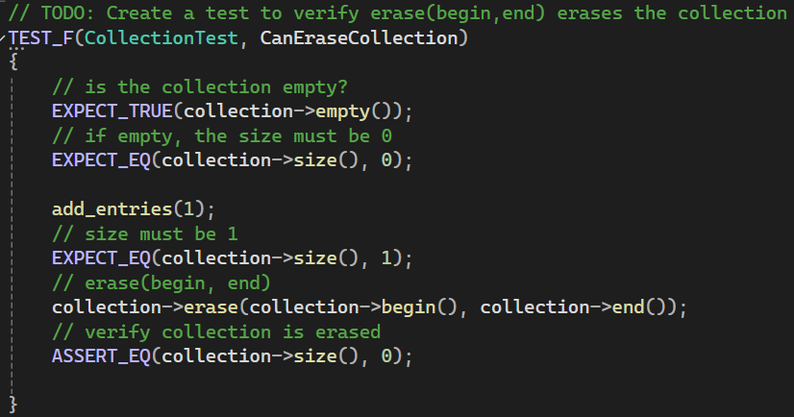
Positive Unit Test

Slide 10
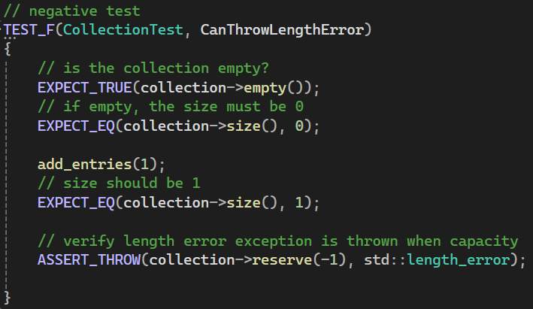
Negative Unit Test

Slide 11

AUTOMATION SUMMARY

Slide 12
RISKS AND BENEFITS
Don't leave security until the end
Efficiency
Cost
Overall Security
Nothing is overlooked
Everything is tested

Slide 13
RECOMMENDATIONS
User Authentication
Verify users
Multi-factor authentication
Accounting
Track activity
Notify of attacks

Slide 14
CONCLUSIONS
Defense in Depth
Many layers of security
Difficult for attackers
Don't leave security until the end
DevSecOps pipeline
Efficient process

Slide 15
REFERENCES
Recently confirmed Myspace hack could be the largest yet. (n.d.). TechCrunch. https://techcrunch.com/2016/05/31/recently-confirmed-myspace-hack-could-be-the-largest-yet/
IBM. (n.d.). What is DevSecOps? | IBM. Www.ibm.com. https://www.ibm.com/topics/devsecops
Fruhlinger, J. (2022, July 28). Defense in depth explained: Layering tools and processes for better security. CSO Online. https://www.csoonline.com/article/573221/defense-in-depth-explained-layering-tools-and-processes-for-better-security.html

